Slide 1
Legal Rights, Responsibilities and Processes: What Latinos Should Know Thursday, November 13, 2014
By Cynthia R. Murray, Esquire

Slide 2
Invited Guest Panelists Darby Lowe, Deputy Commonwealth’s Attorney for Albemarle County Sgt. Darrell Byers, ACPD Officer Jerry Schenk, ACPD

Slide 3
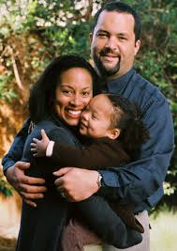
We are glad to have Latino immigrants living in our community.
We start the discussion with the premise that we welcome and embrace people of different cultures and backgrounds in our country and in the Commonwealth of Virginia.
Further, the public has a vested interest in maintaining happy, healthy families and individuals in our communities.
It is possible that Latino members of our community may come into contact with the court system, civilly or criminally. When that happens, we have an obligation to make sure that the contact with our legal system is fair to both the individual resident , the community and the government .

Slide 4
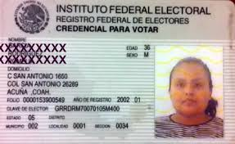
Criminal Issues
What are some of the more prevalent crimes that we are seeing among our Latino population?
Driving Offenses:
No License; Suspended License
DUI/DUID
Hit and Run
False Identification
Domestic Assault/Battery
Failure to Appear

Slide 5
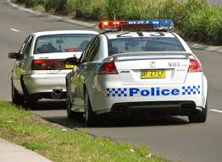
What’s happening?
Many of the individuals in the criminal justice system are undocumented, therefore they cannot obtain a valid driver’s license
The foreign driver’s license is only valid for 60 days pursuant to VA Code Section
They need to work, so they choose to drive. On a second offense of No OL they are normally incarcerated.
The same is true in certain DUI cases and driving on a suspended license second offense or more.
Some suspects carry a valid ID, but many are false. Writing a false name on the summons is a felony. Some suspects flee the scene while others do not come to court – NEW crimes!

Slide 6
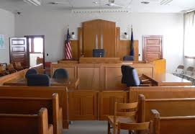
Bond Hearings and Trial
A defendant will have a bond hearing to determine if he/she can be released from jail pending trial. Factors that will be considered are:
Immigration status
Family status
Fixed address
Work status
Financial situation
Criminal history
Nature of current offense
The defendant has the right to have an interpreter to translate from Spanish to English and English to Spanish if it is needed
The defendant, even in an illegal immigrant, also may have a court appointed attorney if he/she qualifies

Slide 7
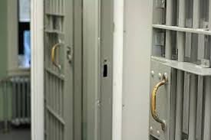
Department of Homeland Security (ICE)
When an undocumented person is incarcerated the Department of Homeland Security Immigration and Customs Enforcement (ICE) Agents are alerted and they may place a federal detainer on the inmate.
ICE has discretion to decide who to detain for deportation proceedings. They will interview the inmate. Several factors will be considered in deciding whether to detain, such as criminal history and family situation.

Slide 8
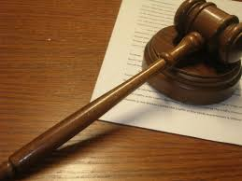
Civil Issues
According to an article from Cornell Law School, “Generally, both legal and illegal immigrants have the right to bring suit in United States federal court. Federal civil rights statutes also expressly permit aliens to bring claims of civil rights violations in federal court. States have generally provided aliens with access to their court systems as well, provided that the alien resides within the particular state.” http://www.law.cornell.edu/wex/alien
Spanish-speaking litigants also may have an interpreter in court, so long as notice is given to the Clerk of Court.

Slide 9
QUESTIONS?
GRACIAS!

